Slide 1
Animal Features & Adaptations
Alabama Wildlife Federation Outdoor Classroom Field Journal Activity
To use this interactive PowerPoint with your students:
Click on “Enable Editing.”
Click the “Slide Show” tab at the top of the screen.
Then choose “From Beginning” from the menu.

Slide 2
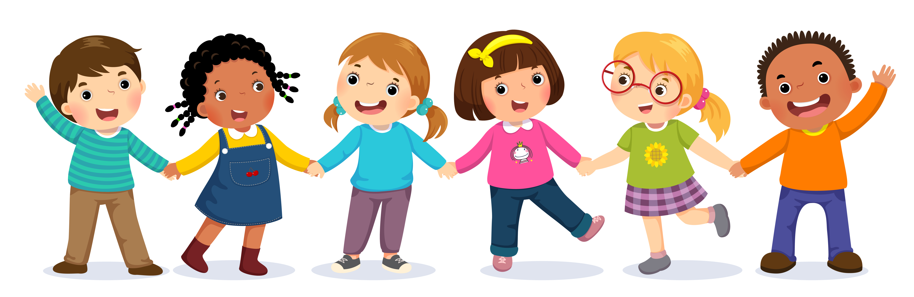
How can we tell each other apart? How do our bodies look different?
Gender – Boy or Girl
Hair Color
Hair Length
Skin Color
Eye Color
These are our features.
Our features make us unique.

Slide 3
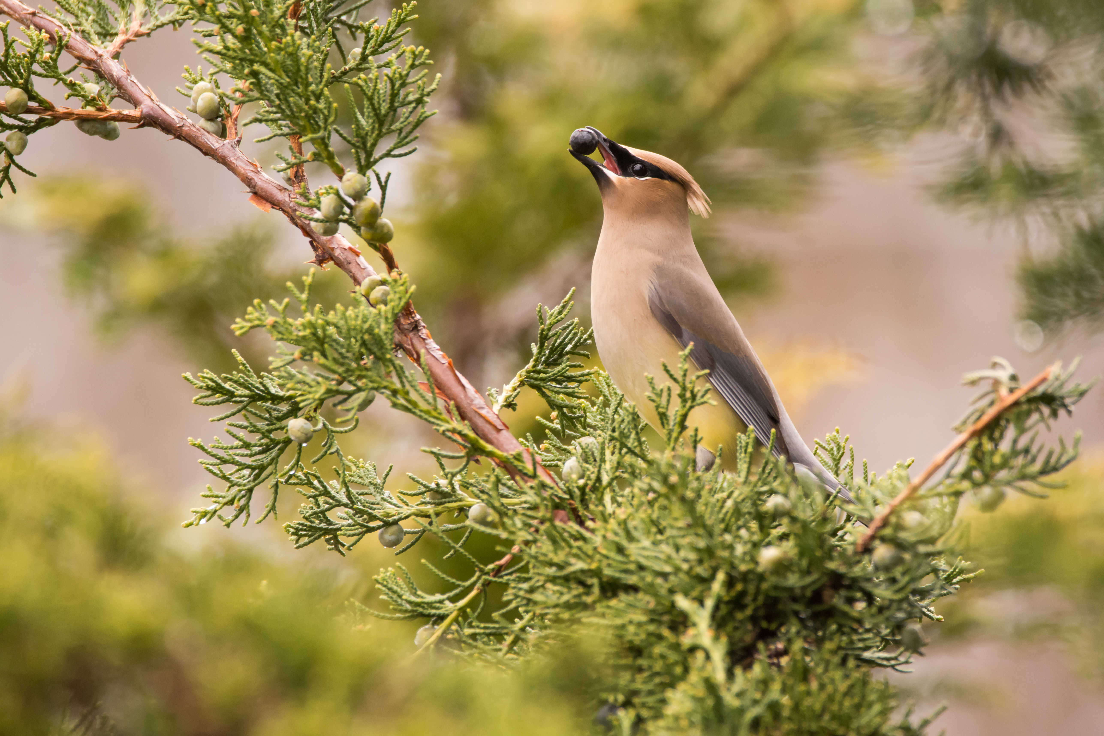
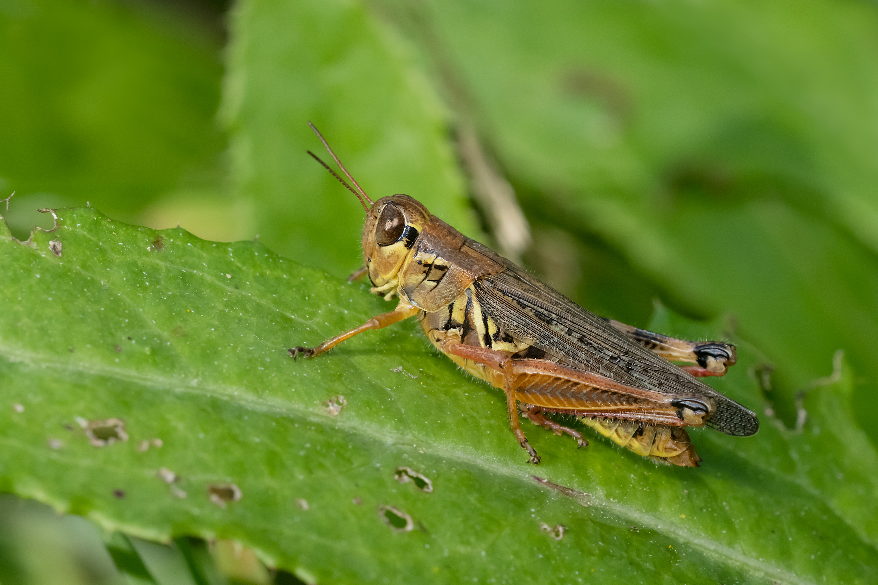
How can we tell animals apart?
How can you tell the difference between a bird and an insect?
Different types of
animals have different types of features too!
1 pair of wings with Feathers
2 pairs of wings
6 legs
2 legs
antennae
beak

Slide 4
How can an animal’s features help it survive?
Wings
- Fly away from predators
Beak
- Eat seeds & berries
Antennae
- Touch & smell
its surroundings to find food
Animals’ features have changed over millions of years to help them survive in their homes or habitat.
These special features are called adaptations.

Slide 5
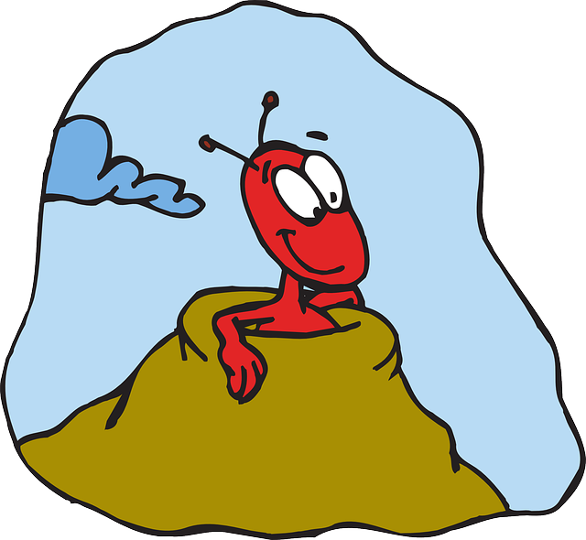
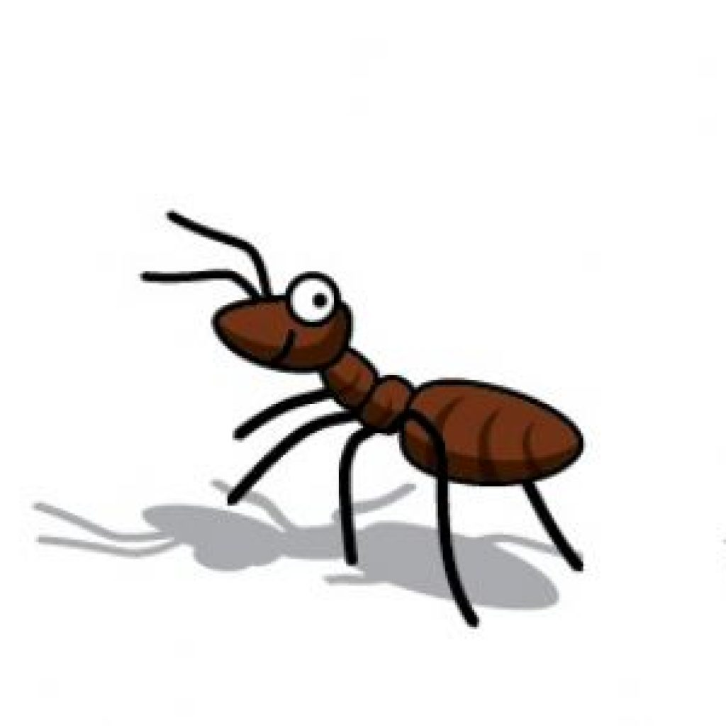
How does a tiny ant stay alive when everything is so much bigger?
It can hide in its anthill,
but it has to come out to search for food.

Slide 6
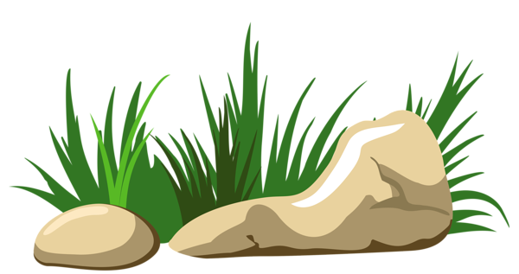
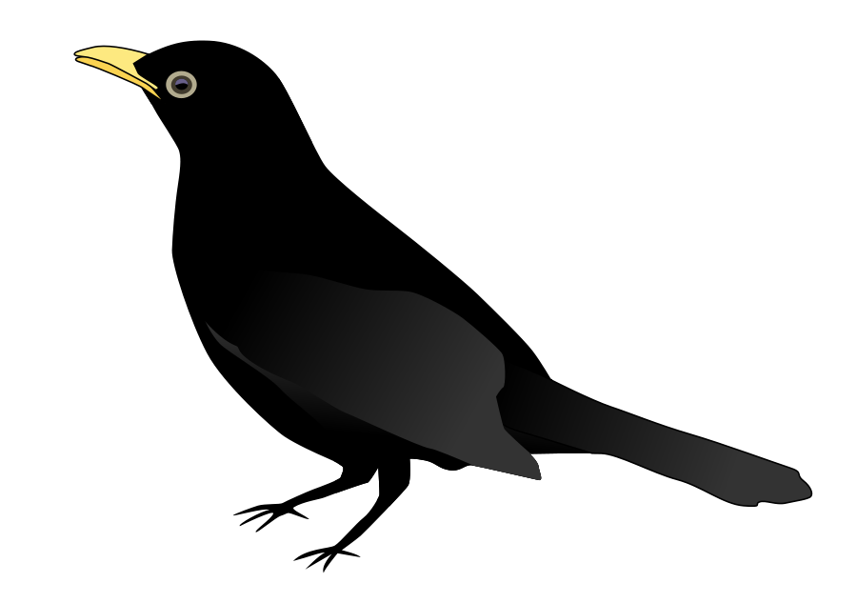
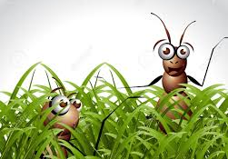
How does the ant’s size help it survive?
You can’t see us!
I am a predator. I eat other animals.
It can hide easily from predators,
and duck into small spaces.

Slide 7
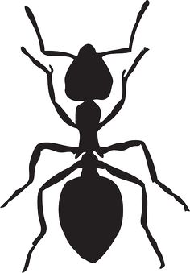
How is an ant’s body different than our body?
An ant has a hard exoskeleton on the outside of its body for support and protection.
Humans’ skeletons are hidden under our soft skin and hair.
https://askabiologist.asu.edu/explore/ant-anatomy

Slide 8
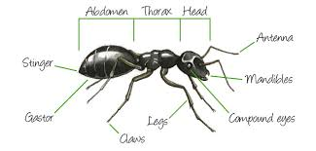
How does an ant use its body to touch, taste, and smell?
Humans’ bodies have:
2 arms & 2 hands to reach out to touch,
a mouth to taste &
a nose to smell.
An ant has 2 antennae on its head that reach out to touch, taste, and smell everything.
https://askabiologist.asu.edu/explore/ant-anatomy

Slide 9
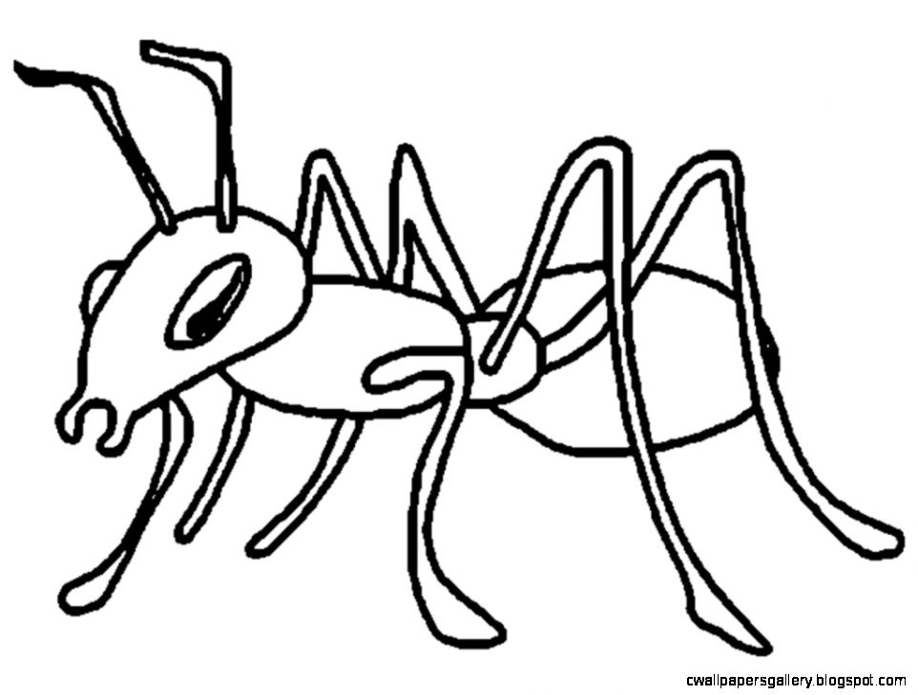
How does an ant hold and carry things? How does it bite or eat?
An ant’s body has mandibles for holding and carrying things or for biting.
Humans’ bodies have 2 arms and 2 hands to hold and carry things, and we use our teeth and mouths for biting and eating.
mandibles
It uses its mouth, which is hidden behind the mandibles, to eat.
https://askabiologist.asu.edu/explore/ant-anatomy

Slide 10
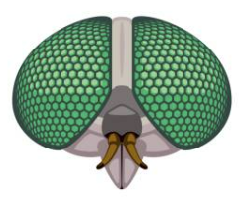
How are an ant’s eyes different than ours?
An ant has 2 compound eyes that contain hundreds of camera-like lenses that help detect movement on both sides of the ant without it having to turn its head.
Humans have 2 eyes that have 1 camera-like lens that allows us to see in great detail, but we cannot see things next to us without moving our heads left or right.
https://askabiologist.asu.edu/explore/ant-anatomy

Slide 11
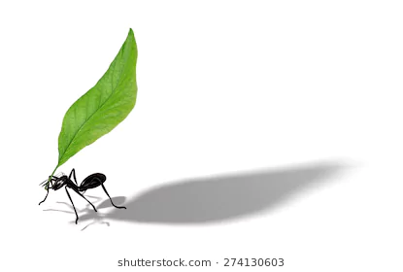
How can an ant’s neck help it survive?
The neck joint of a common American field ant can withstand pressures up to 5,000 times greater than its own body weight,
so it can carry food back to its colony in the anthill.
https://entomologytoday.org/2014/02/11/ants-can-lift-up-to-5000-times-their-own-body-weight-new-study-suggests/
That would be like you carrying 10 cars with one hand!

Slide 12
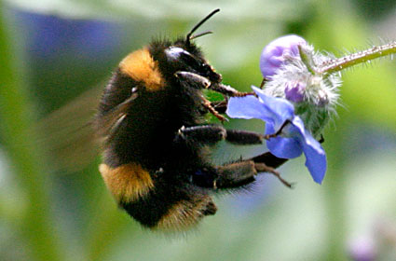
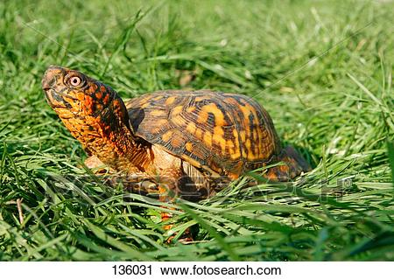
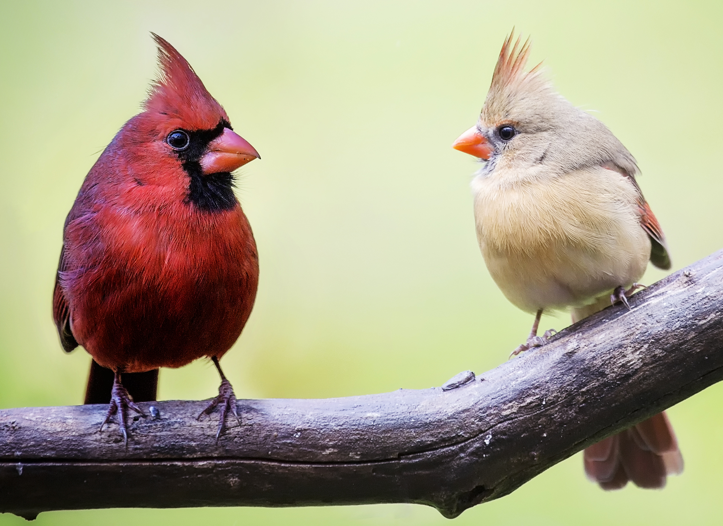
What other types of animals could we find in our outdoor classroom?
How do their bodies’ features or adaptations help them survive?
Bee’s Tongue:
(called a pro-bos-cis)
long tube to suck out nectar from flowers
Turtle’s Shell:
protection from predators & camouflage
Bird’s Feathers:
help male birds attract female birds to mate

