Slide 1
Alabama Outdoor Classroom Box Turtle Research Program
Instructions for Taking Measurement and Annuli Data
*Annuli Count is not required for permit renewal. Measurement data is required.
Use these instructions to safely gather and record the data for your
“Box Turtle Measurement & Annuli Data Form“ in your Box Turtle Research Folder
and in your online “Measurement & Annuli Data” for each turtle.

Slide 2
IMPORTANT INFORMATION!
Placing your turtle on its back can be dangerous due to the location of its lungs under its shell.
If you must flip the turtle over for any data collection, move quickly and safely.
You risk injuring the turtle if you leave it on its back for longer than one minute at a time.

Slide 3
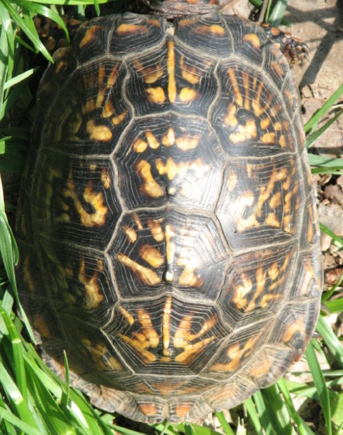
For reference:
The carapace (left) is
the top of the shell.

Slide 4
For reference:
The carapace (left) is
the top of the shell.
The plastron (right) is the
bottom of the shell. Note
that the plastron begins
and ends within the
margins of the carapace (marked with red lines).

Slide 5
For reference:
The carapace (left) is
the top of the shell.
The plastron (right) is the
bottom of the shell. Note
that the plastron begins
and ends within the
margins of the carapace (marked with red lines).
The box turtle’s characteristic hinge (right) is found on the plastron (marked with blue line).

Slide 6
Quick Tips
Be sure to use the very end of the measuring tape as your starting point to get an accurate measurement.
Refer to these Typical Box Turtle Measurements when collecting your data. If your numbers are far outside of the normal range, double check that you are using the correct unit of measurement and following instructions completely, and then take measurements/ weight again.
Carapace length and width: 10 – 18 cm
Plastron length: 8 – 16 cm (usually 2-3 cm smaller than carapace length & width)
Plastron width: 5 – 9 cm (usually around half the size of the carapace length & width)
Shell height: 5 – 9 cm (usually 1-2 cm smaller than the plastron width)
Weight: 200 – 600 grams

Slide 7
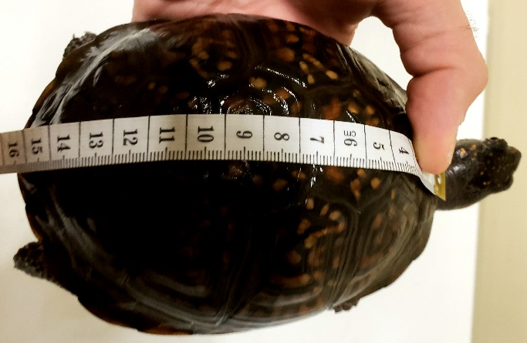
Measuring the Carapace (top of shell) Tools needed: soft measuring tape
Length
Holding your turtle securely, stretch measuring tape from the top edge of the carapace down the center of the carapace to the bottom edge.
Measure in centimeters.

Slide 8
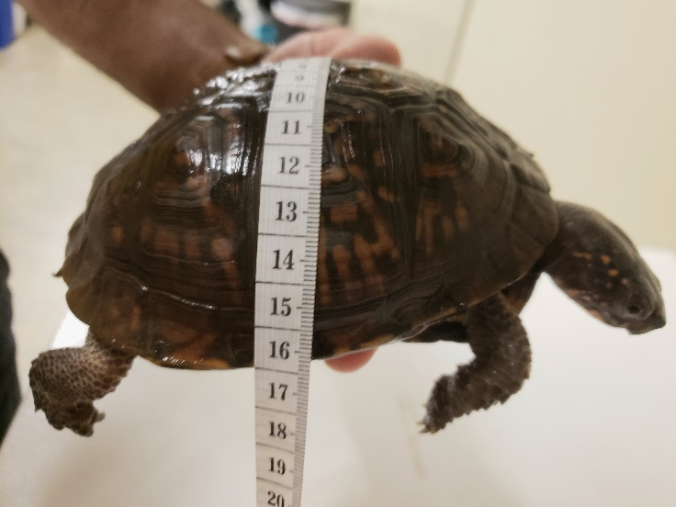
Measuring the Carapace (top of shell) Tools needed: soft measuring tape
Width
Holding your turtle securely, stretch measuring tape from the left edge of the carapace across the center to the opposite edge.
Measure in centimeters.

Slide 9
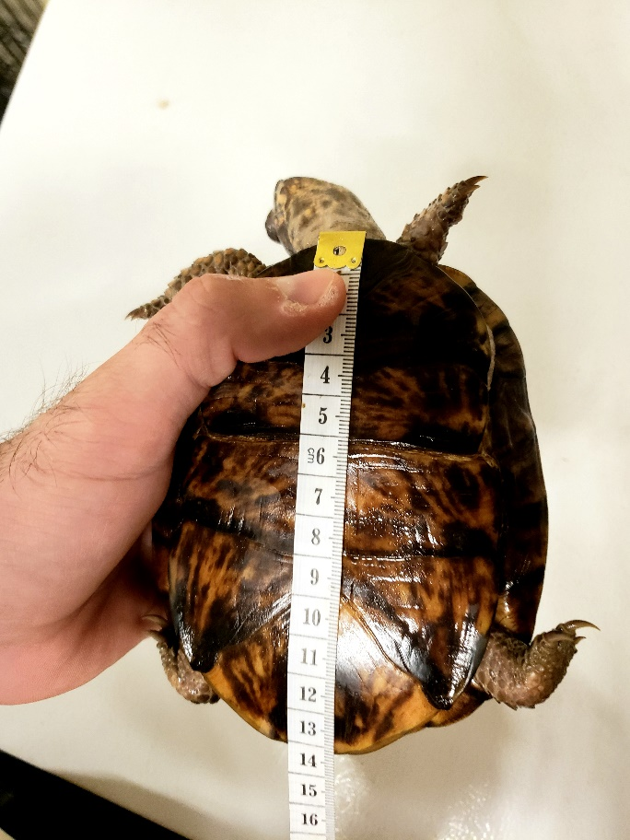
Measuring the Plastron (bottom of shell) Tools needed: soft measuring tape
Length
Holding your turtle securely, stretch measuring tape from the top edge of the plastron down the center of the plastron to the bottom edge.
Measure in centimeters.

Slide 10
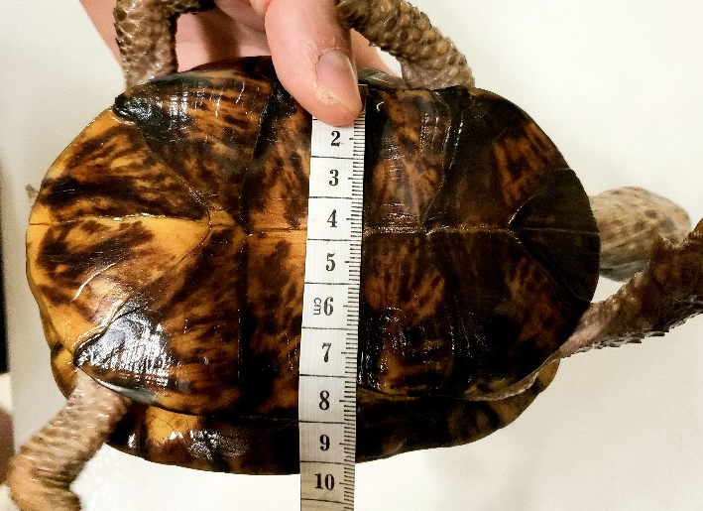
Measuring the Plastron (bottom of shell) Tools needed: soft measuring tape
Width
Holding your turtle securely, stretch measuring tape from the left edge of the plastron across the center to the opposite edge.
Measure at hinge, in centimeters.

Slide 11
Measuring the Shell’s Height Tools needed: Popsicle stick, level, and ruler
Step 1: Carefully flip your turtle onto its back. Move quickly from this point on. Step 2: Place a popsicle stick across the turtle’s plastron along the hinge. Step 3: Place the level on top of the popsicle stick. Step 4: Once you have the stick and level secure, stand the ruler up vertically and measure the turtle’s height. Tip: The turtle’s hinge usually correlates with the tallest point on the shell, so be sure you take your measurements from this point on the plastron. Measure in centimeters.

Slide 12
Weighing your Turtle
Tracking your turtle’s weight over time will not only allow you
to track its growth, but also its health.
Some degree of weight loss during brumation or as seasons change is normal. However, your turtle should not lose more than 1% of its body weight per month. Use this information to calculate how much your turtle could safely lose versus what it has lost at each weigh-in.
Depending on these numbers, you may need to visit a veterinarian.

Slide 13
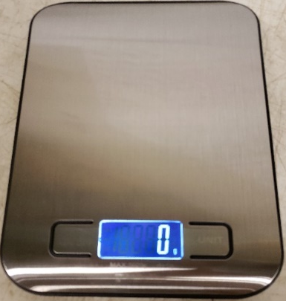
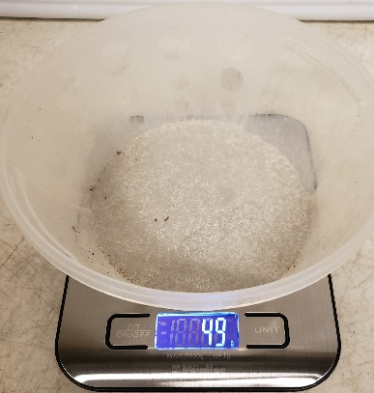
Weighing the Turtle Tools needed: scale, bowl
Step 1:
Place scale on sturdy, solid surface. Press the “on/off” button to turn the scale on. The display screen should light up and show a zero.
Step 2:
Place the bowl on the scale and wait for reading of bowl’s weight. Measure in grams. Press the “unit” button on right of screen to select “grams”.

Slide 14
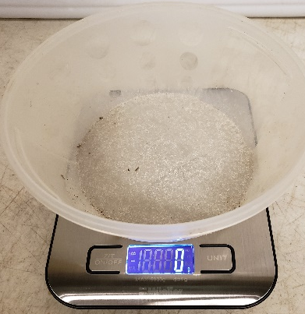
Weighing the Turtle Tools needed: scale, bowl
Step 3:
Leave the bowl on the scale and press the “on/off” button again. The display screen should show a zero. Now the scale will measure only the turtle’s weight when you place it in the bowl.
Step 4:
Place the turtle in the bowl to measure its weight. If your turtle is moving, the reading will fluctuate. The more still the turtle is, the more accurate the reading.

Slide 15
Weighing the Turtle
Tip!
If your turtle is too squirmy, try to flip it on its back to immobilize it.
Remember that you must move quickly!

Slide 16
Counting the Number of Annuli
Scutes are defined plates.
The plates on a turtle’s shell are called scutes, on which you can see growth rings.
These growth rings are called annuli, and despite what many believe they do not represent one year of growth. They actually represent growth depending on resource availability, rainfall, and nesting activity (in females).
Within each scute, the natal scute (labelled “0”) can be identified as in the diagram. This image over simplifies the clarity of the rings and their distinctiveness.
Image source: https://boxturtle.uncg.edu/

Slide 17
Counting the Number of Annuli
Turtles with worn or smooth areas on the shell are thought to be older than other turtles of the same size with unworn scutes and clearly defined annuli, though this is uncertain.
A smooth shell may have been worn down by friction of the soil, sand, or forest debris in the same way sandpaper smooths rough surfaces.

Slide 18
Counting the Number of Annuli
*Annuli Count is not required for permit renewal.
Counting annuli can be very tricky, as the rings are not always clear and defined, and they can change over time. Therefore, annuli counts cannot be trusted as accurate estimates of age and photos are important for comparison and re-evaluation of annuli counts in the future.
While these rings are not a great indicator of the turtle’s age, the information is still valuable because one day we might know more about what these annuli really mean for turtles in the wild. At that point, we will have data points to contribute to research.

Slide 19
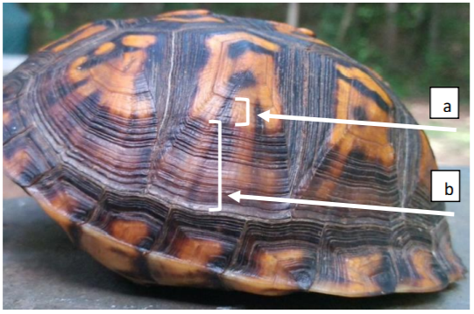
Counting the Number of Annuli
It is very important that you are consistent in what you count as an annulus.
a) This cluster of annuli shows that some rings are much shallower than others. You could count these as 1 annulus.
b) This cluster of annuli also has rings much shallower than others, so you couldcount these as 1 annulus.
c) If you continue to only count the annuli with deeper ridges, then this cluster could be counted as 12 annuli.
The final annuli count for this scute would be 14 rings if you qualified annuli as we did above.
a
b
c
Image source: https://boxturtle.uncg.edu/

Slide 20
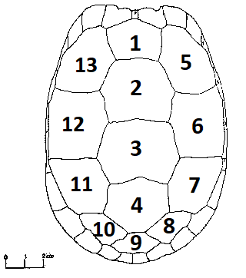
Counting the Number of Annuli Tools needed: magnifying glass
Step 1: If this is your first annuli count, pick a scute (using the diagram on the right) and take a closeup photo of your turtle’s shell and the scute you selected.
The photo on the previous slide is a great example of how you can frame your own. Your scute may be located in a different location on your turtle’s shell than the one in the photo above, so your photo may not look exactly the same.
Just do your best to take a photo that shows which scute you selected as well as its annuli.

Slide 21
Counting the Number of Annuli Tools needed: magnifying glass
Step 1 (continued): If an annuli count has been done for your turtle previously, refer to the photo(s) in the “Photo(s) of the Turtle’s Scute used for the Annuli Count” in your online Measurement & Annuli Data for this turtle to see which scute was selected for counts. Use this same annuli for each count. Retake the photo and submit it along with your NEW annuli count. Standardizing the photo and the counting process will make your results more accurate.

Slide 22
Counting the Number of Annuli Tools needed: magnifying glass
Step 2: Use your magnifying glass if needed to count the number of rings within the scute you have selected. Count three times and record your average result. You may only count rings with a deep ridge, or you may count each ring you can see clearly enough. However you decide to qualify a scute, be sure to do it the same way each time you count. Consistency is key!
Step 3: To get the average number of rings, add the number of rings from each count together, and then divide by 3. Record your average annuli count range: 1-3, 4-7, 8-11, 12-15, 16-19, or 20+.

